Slide 1
Context Sensitive Analysis
Attribute Grammar
Chapter-4 (Keith Cooper)
Nalinadevi Kadiresan, CSE DEPT.
AMRITA SCHOOL OF ENGG.

Slide 2
Now We Know How To Build Parsers …
Basically, we use parsers to understand syntax
Beyond syntax why do we need parser?
Obvious answer is “to build IR that will be compiled or interpreted”
Also, Parsers have many applications
  Reading markup languages: XML, EPUB, GML & KML, RSS and building data structures to represent the content of various ML documents
  Reading other data representations (e.g., YAML) to transmit data in a rich and structured form
  Reading in the results of other language processing tools: e.g., EDIF
General Schema of the phases
  Read some input
  Build some data structures to model the input
  Perform some structured computation
Even Semester 2017-18
Nalinadevi Kadiresan

Slide 3
The course Is About Compiler Construction
What else does a compiler need to know about the input program?
Compiler must ensure coherent use of information, that is, consistent type system
Compiler must assign storage to every item that needs storage
Compiler must plan resource allocation & recycling
Compiler must generate target code for every construct that is executable
The compiler is guided in this effort by the actual code, the language definition, and its knowledge about the runtime environment.
Meta Issue:
The compiler does its work at compile time
The compiler emits code that performs the work at runtime
Keeping track of the times (design, compile, run) is critical to your understanding of the material
Even Semester 2017-18
Nalinadevi Kadiresan

Slide 4
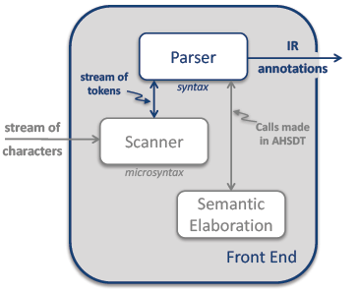
Role of Parser in Front End
A parser’s other(than syntax) activities can be termed “semantic elaboration.”
It may perform many tasks, including
  Type checking
  Code generation
  Storage layout
  Error checking
It might create an IR & interpret that IR to produce answers
It might pretty-print the code back to a file in some modified form.
Semantic elaboration makes parsers quite versatile tools.
Even Semester 2017-18
Nalinadevi Kadiresan

Slide 5
Beyond Syntax
There is a level of correctness that is deeper than grammar
fie(int a, int b, int c, int d) { … }
fee() {
int f[3],g[0], h, i, j, k;
char *p;
fie(h,i,“ab”,j, k);
k = f * i + j;
h = g[17];
printf(“<%s,%s>.\n”, p,q);
p = 10;
}
What is wrong with this program?
(let me count the ways …)
declared g[0], used g[17]
wrong number of args to fie()
“ab” is not an int
wrong dimension on use of f
undeclared variable q
10 is not a character string
All of these are “deeper than syntax”
To generate code, we need to understand its meaning !
Even Semester 2017-18
Nalinadevi Kadiresan

Slide 6
Beyond Syntax
To generate code, the compiler needs to answer many questions
Is “x” a scalar, an array, or a function? Is “x” declared?
Are there names that are not declared? Declared but not used?
Which declaration of “x” does each use reference?
Is the expression “x * y + z” type-consistent?
In “a[i,j,k]”, does a have three dimensions?
Where can “z” be stored? (register, local, global, heap, static)
In “f ← 15”, how should 15 be represented?
How many arguments does “fie()” take? What about “printf ()” ?
Does “*p” reference the result of a “malloc()” ?
Do “p” & “q” refer to the same memory location?
Is “x” defined before it is used?
These are beyond a CFG
Even Semester 2017-18
Nalinadevi Kadiresan

Slide 7
Beyond Syntax
These questions are part of context-sensitive analysis
Answers depend on values( or lexemes), not parts of speech(or syntactic categories)
Questions & answers involve non-local information
Answers may involve computation
How can we answer these questions?
Use formal methods
  Context-sensitive grammars?
  Attribute grammars? (attributed grammars?)
Use ad-hoc techniques
  Symbol tables
  Ad-hoc code (action routines)
.
Even Semester 2017-18
Nalinadevi Kadiresan

Slide 8
What is Context-Sensitive Analysis?
The meaning of structures(or syntax) is realized only in context to another structure.
  This means that the analysis requires the knowledge connection of two or more structures to realize the meaning
Example: Type of a variable observed by connecting variable declaration and usage.
Even Semester 2017-18
Nalinadevi Kadiresan

Slide 9
Beyond Syntax
Telling the story
The attribute grammar formalism is important
  Succinctly makes many points clear
  Sets the stage for actual, ad-hoc practice
The problems with attribute grammars motivate practice
  Non-local computation
  Need for centralized information
Some folks still argue for attribute grammars
  Knowledge is power
  Information is immunization
We will cover attribute grammars, then move on to ad-hoc ideas
Even Semester 2017-18
Nalinadevi Kadiresan

Slide 10
Static and Dynamic Semantics
Syntax concerns the form of a valid program, while semantics concerns its meaning
Static semantic rules are enforced by a compiler at compile time
  Implemented in semantic analysis phase of the compiler
  Context-free grammars are not powerful enough to describe certain rules, such as checking variable declaration with variable use
  Examples: Type checking; Identifiers are used in appropriate context; Check subroutine call arguments; Check labels
Dynamic semantic rules are enforced by the compiler by generating code to perform the checks
  Examples: Array subscript values are within bounds; Arithmetic errors; Pointers are not dereferenced unless pointing to valid object; A variable is used but hasn't been initialized
  Some languages (Euclid, Eiffel) allow programmers to add explicit dynamic semantic checks in the form of assertions, e.g assert denominator not= 0
  When a check fails at run time, an exception is raised
Even Semester 2017-18
Nalinadevi Kadiresan

Slide 11
Attribute Grammars
What is an attribute grammar?
A context-free grammar augmented with a set of semantic rules (also called as Syntax directed definition(SDD))
Attributes have values that hold semantic information about the (non)terminal
General form:
Semantic rules are used by a compiler to enforce static semantics and/or to produce an abstract syntax tree while parsing token stream
Can also be used to build simple language interpreters
Production | Semantic Rules
A → B + C | A.a := B.b + C.c
Even Semester 2017-18
Nalinadevi Kadiresan

Slide 12
Attributes
Attribute is any quantity associated with a programming construct.
  Example: data types, line numbers, instruction details
Two kinds of attributes: for a non-terminal A, at a parse tree node N
  A synthesized attribute
  An inherited attribute
Even Semester 2017-18
Nalinadevi Kadiresan

Slide 13
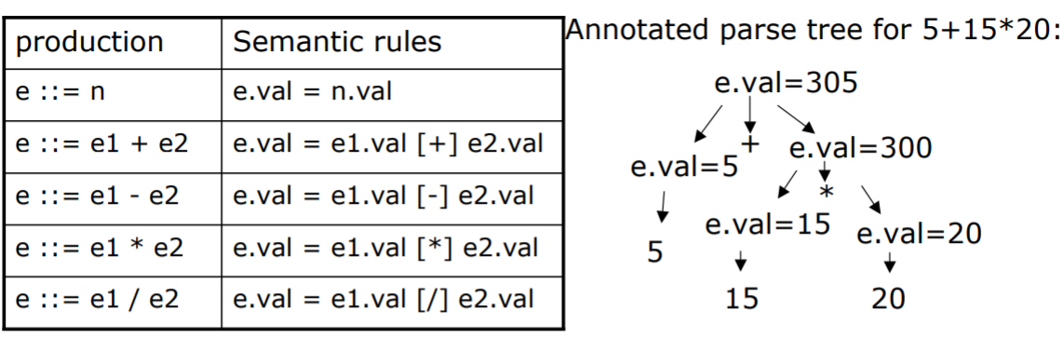
Synthesized Attributes
An attribute is synthesized if in the parse tree,
  Attributes of parents are determined from those of children
Synthesized attributes can be evaluated through post-order traversal of parse tree
Even Semester 2017-18
Nalinadevi Kadiresan

Slide 14
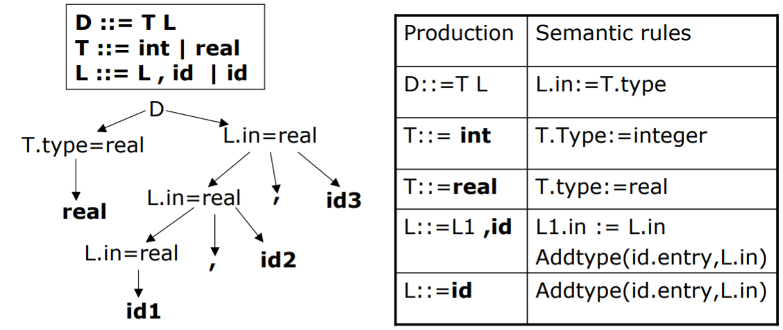
Inherited Attributes
An attribute is inherited if
  The attribute value of a parse-tree node is determined from attribute values of its parent and siblings
  They are evaluated using depth first traversal
Even Semester 2017-18
Nalinadevi Kadiresan

Slide 15
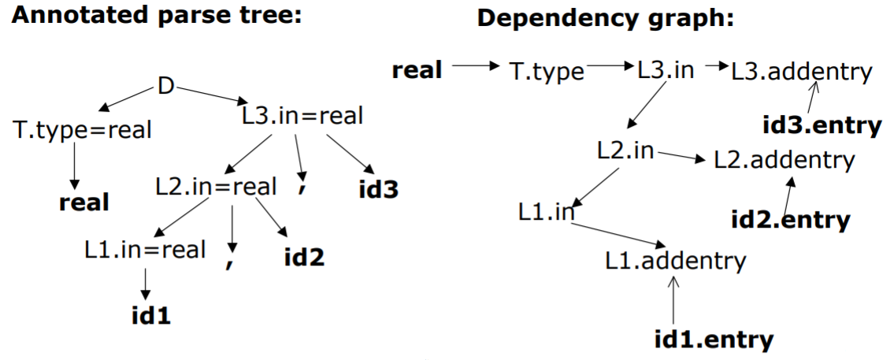
Dependences In Attribute Evaluation
If value of attribute b depends on attribute c,
  Value of b must be evaluated after evaluating value of c
  There is a dependence from c to b
Even Semester 2017-18
Nalinadevi Kadiresan

Slide 16
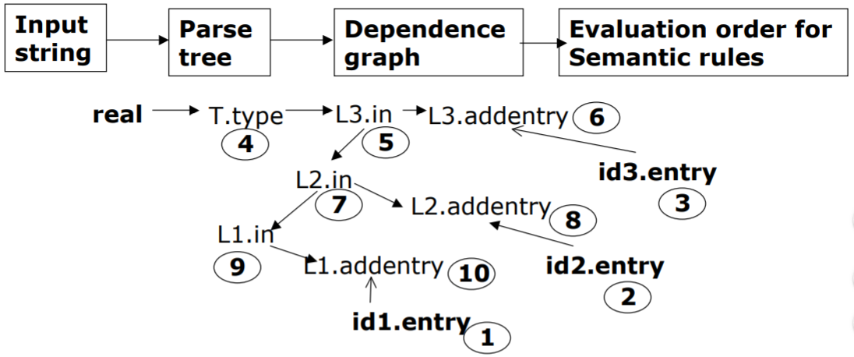
Evaluation Order Of Attributes
Topological order of the dependence graph
  Edges go from nodes earlier in the ordering to later nodes
  No cycles are allowed in dependence graph
Even Semester 2017-18
Nalinadevi Kadiresan

Slide 17
Evaluation Methods
Dynamic, dependence-based methods
Build the parse tree
Build the dependence graph
Topological sort the dependence graph
Define attributes in topological order
Rule-based methods (treewalk)
Analyze rules at compiler-generation time
Determine a fixed (static) ordering
Evaluate nodes in that order
Oblivious methods (passes, dataflow)
Ignore rules & parse tree
Pick a convenient order (at design time) & use it
Even Semester 2017-18
Nalinadevi Kadiresan

Slide 18
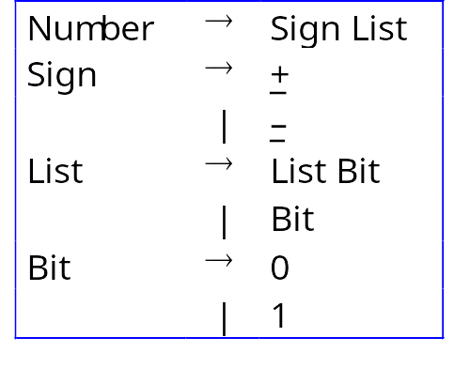
Synthesized And Inherited Attributes
Example grammar
This grammar describes signed binary numbers
We would like to augment it with rules that compute the decimal value of each valid input string
Even Semester 2017-18
Nalinadevi Kadiresan

Slide 19
Synthesized And Inherited Attributes
Number → Sign List
→ – List
→ – Bit
→ – 1
For “–1”
For “–101”
Number → Sign List
→ Sign List Bit
→ Sign List 1
→ Sign List Bit 1
→ Sign List 1 1
→ Sign Bit 0 1
→ Sign 1 0 1
→ – 101
Number
Sign
List
–
List
Bit
Number
List
Bit
1
Sign
List
Bit
0
–
Bit
1
1
We will use these two throughout the lecture
Even Semester 2017-18
Nalinadevi Kadiresan

Slide 20
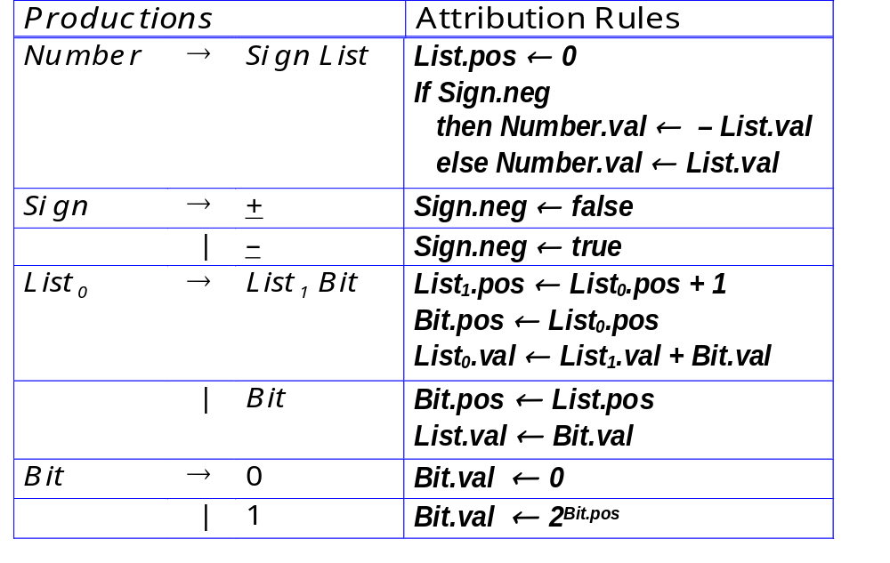
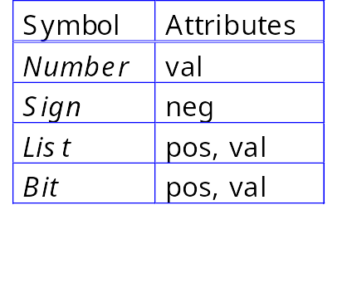
Synthesized And Inherited Attributes
Add rules to compute the decimal value of a signed binary number
Even Semester 2017-18
Nalinadevi Kadiresan

Slide 21
Synthesized And Inherited Attributes
Rules + parse tree imply an attribute dependence graph
For “–1”
Number.val ← – List.val ≡ –1
One possible evaluation order:
  List.pos
  Sign.neg
  Bit.pos
  Bit.val
  List.val
  Number.val
Other orders are possible
Number
neg ← true
Sign
List
List.pos ← 0
List.val ← Bit.val ≡ 1
–
Bit
Bit.pos ← 0
Bit.val ← 2^{Bit.pos} ≡ 1
1
Knuth suggested a data-flow model for evaluation
Independent attributes first
Others in order as input values become available
Evaluation order must be consistent with the attribute dependence graph
Even Semester 2017-18
Nalinadevi Kadiresan

Slide 22
Synthesized And Inherited Attributes
Number
Sign
List
–
List
Bit
List
Bit
1
Bit
0
1
For “–101”
Even Semester 2017-18
Nalinadevi Kadiresan

Slide 23
Synthesized And Inherited Attributes
Number
val: –5
Inherited Attributes
Sign
List
pos: 0
val: 5
neg: true
–
List
pos: 1
val: 4
Bit
pos: 0
val: 1
pos: 2
val: 4
pos: 1
val: 0
List
Bit
1
Bit
pos: 2
val: 4
0
1
For “–101”
Even Semester 2017-18
Nalinadevi Kadiresan

Slide 24
Synthesized And Inherited Attributes
Number
val: –5
Synthesized attributes
Sign
List
pos: 0
val: 5
neg: true
–
List
pos: 1
val: 4
Bit
pos: 0
val: 1
pos: 2
val: 4
pos: 1
val: 0
List
Bit
1
Bit
pos: 2
val: 4
0
1
For “–101”
Even Semester 2017-18
Nalinadevi Kadiresan

Slide 25
Synthesized And Inherited Attributes
Number
val: –5
Synthesized attributes
Sign
List
pos: 0
val: 5
neg: true
–
List
pos: 1
val: 4
Bit
pos: 0
val: 1
pos: 2
val: 4
pos: 1
val: 0
List
Bit
1
Bit
pos: 2
val: 4
0
1
For “–101”
Even Semester 2017-18
Nalinadevi Kadiresan

Slide 26
Synthesized And Inherited Attributes
Number
val: –5
If we show the computation ...
Sign
List
pos: 0
val: 5
& then peel away the parse tree ...
neg: true
–
List
pos: 1
val: 4
Bit
pos: 0
val: 1
pos: 2
val: 4
pos: 1
val: 0
List
Bit
1
Bit
pos: 2
val: 4
0
1
For “–101”
Even Semester 2017-18
Nalinadevi Kadiresan

Slide 27
Back to the Example
All that is left is the attribute dependence graph.
This succinctly represents the flow of values in the problem instance.
The dynamic methods sort this graph to find independent values, then work along graph edges.
The rule-based methods try to discover “good” orders by analyzing the rules.
The oblivious methods ignore the structure of this graph.
val: –5
pos: 0
val: 5
neg: true
–
pos: 1
val: 4
pos: 0
val: 1
pos: 2
val: 4
pos: 1
val: 0
1
pos: 2
val: 4
0
1
For “–101”
The dependence graph must be acyclic
Even Semester 2017-18
Nalinadevi Kadiresan

Slide 28
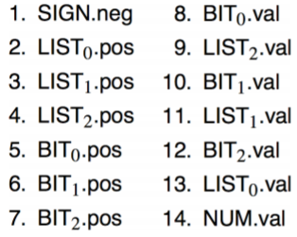
Synthesized And Inherited Attributes
nodes represent attributes
edges represent flow of values
graph must be acyclic
topologically sort to order attributes
  use this order to evaluate rules
  order depends on both grammar and input string!
Evaluating in this order yields NUM.val = -5
Number
val: –5
Sign
List₀
pos: 0
val: 5
neg: true
–
List₁
pos: 1
val: 4
Bit₂
pos: 0
val: 1
pos: 2
val: 4
pos: 1
val: 0
List₂
Bit₁
1
Bit₀
pos: 2
val: 4
0
1
Even Semester 2017-18
Nalinadevi Kadiresan

Slide 29
The Rules of the Game
Attributes associated with nodes in parse tree
Rules are value assignments associated with productions
Attribute is defined once, using local information
Label identical terms in production for uniqueness
Rules & parse tree define an attribute dependence graph
  Graph must be non-circular
This produces a high-level, functional specification
Synthesized attribute
  Depends on values from children
Inherited attribute
  Depends on values from siblings & parent
Even Semester 2017-18
Nalinadevi Kadiresan

Slide 30
Using Attribute Grammars
Attribute grammars can specify context-sensitive actions
Take values from syntax
Perform computations with values
Insert tests, logic, …
Synthesized Attributes
Use values from children
& from constants
S-attributed grammars
Evaluate in a single
bottom-up pass
Good match to LR parsing
Inherited Attributes
Use values from parent,
constants, & siblings
directly express context
can rewrite to avoid them
Thought to be more natural
Not easily done at parse time
We want to use both kinds of attribute
Even Semester 2017-18
Nalinadevi Kadiresan

Slide 31
Circularity
We can only evaluate acyclic instances
We can prove that some grammars can only generate instances with acyclic dependence graphs
Largest such class is “strongly non-circular” grammars (SNC )
SNC grammars can be tested in polynomial time
Failing the SNC test is not conclusive
Many evaluation methods discover circularity dynamically
⇒ Bad property for a compiler to have
SNC grammars were first defined by Kennedy & Warren
Even Semester 2017-18
Nalinadevi Kadiresan

Slide 32
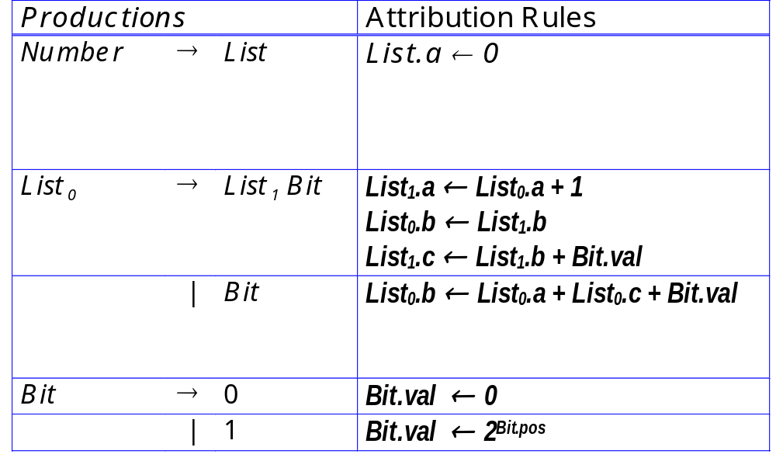
A Circular Attribute Grammar
Even Semester 2017-18
Nalinadevi Kadiresan

Slide 33
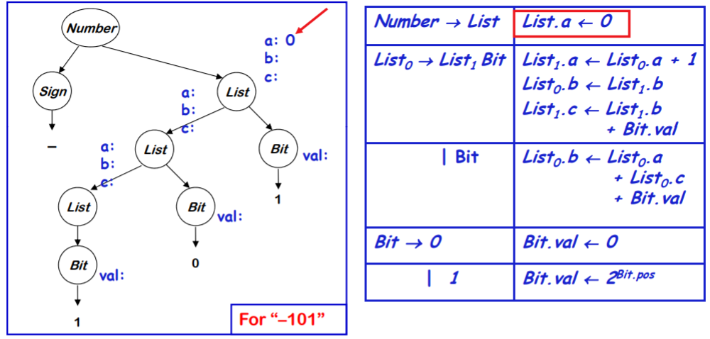
A Circular Attribute Grammar
Even Semester 2017-18
Nalinadevi Kadiresan

Slide 34
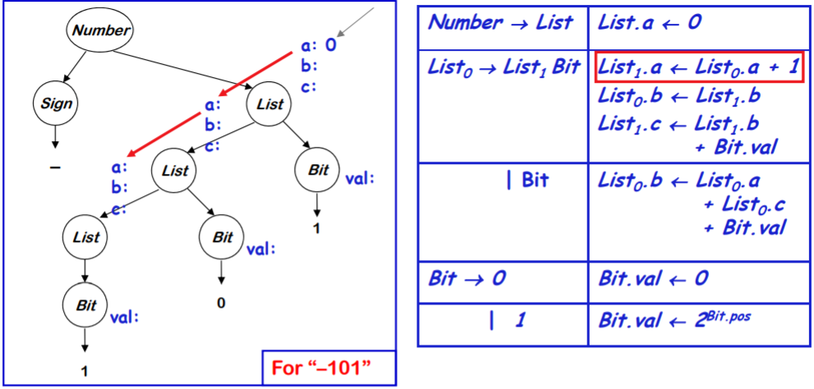
A Circular Attribute Grammar
Even Semester 2017-18
Nalinadevi Kadiresan

Slide 35
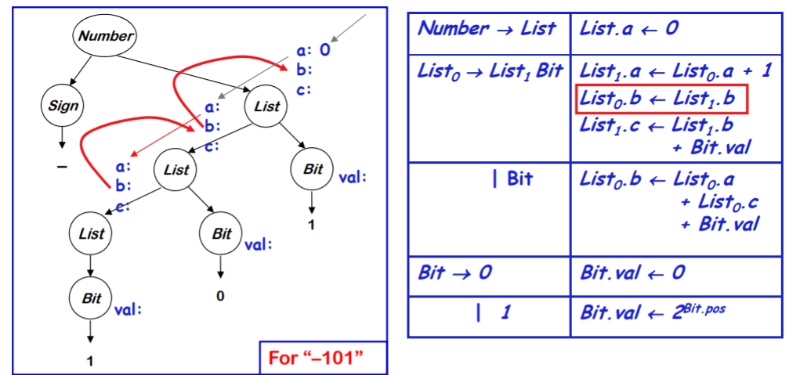
A Circular Attribute Grammar
Even Semester 2017-18
Nalinadevi Kadiresan

Slide 36
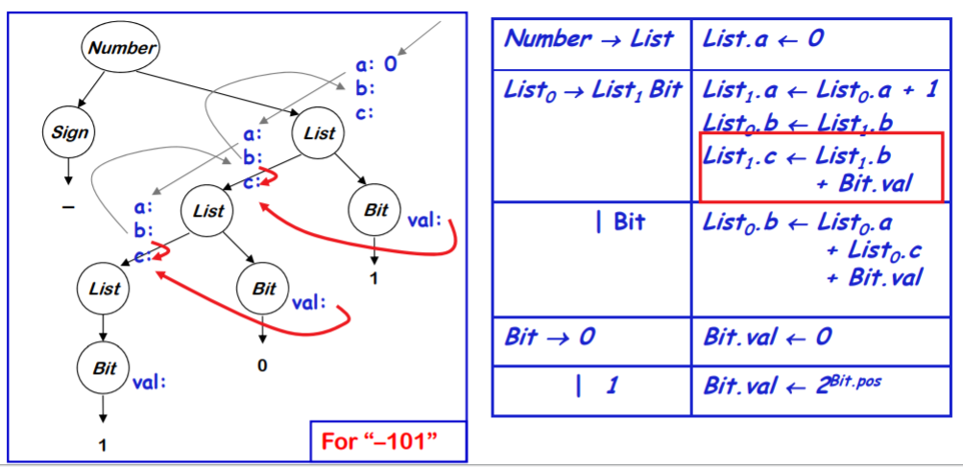
A Circular Attribute Grammar
Even Semester 2017-18
Nalinadevi Kadiresan

Slide 37
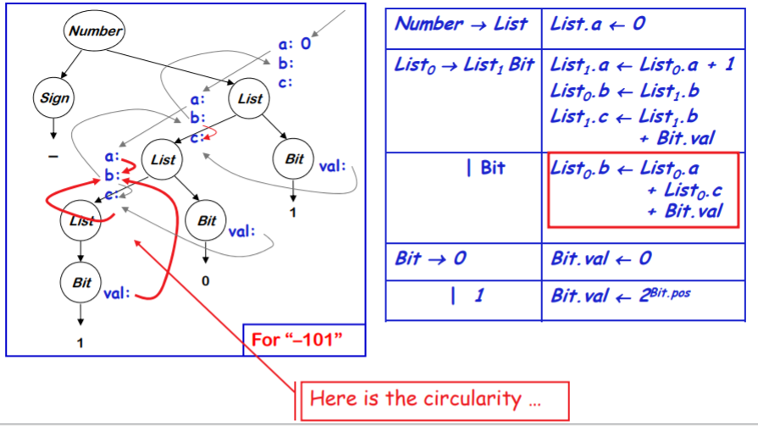
A Circular Attribute Grammar
Even Semester 2017-18
Nalinadevi Kadiresan

Slide 38
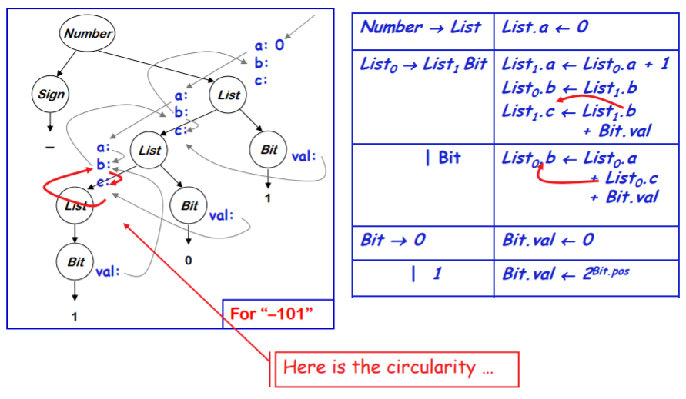
A Circular Attribute Grammar
Even Semester 2017-18
Nalinadevi Kadiresan

Slide 39
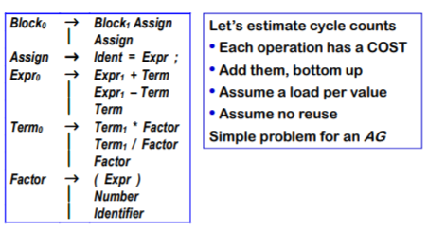
Example to study the Power of Attribute grammar
Grammar for a basic block
Even Semester 2017-18
Nalinadevi Kadiresan

Slide 40
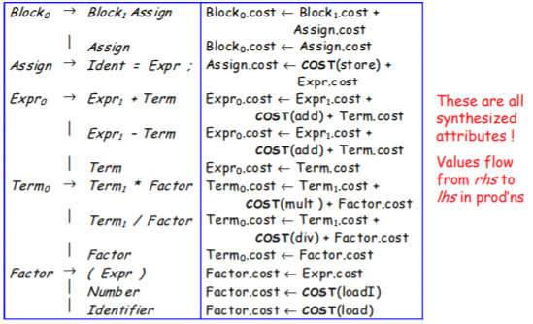
Example to study the Power of Attribute grammar
Even Semester 2017-18
Nalinadevi Kadiresan

Slide 41
Example to study the Power of Attribute grammar
Properties of the example grammar
All attributes are synthesized ⇒ S-attributed grammar
Rules can be evaluated bottom-up in a single pass
  → Good fit to bottom-up, shift/reduce parser
Easily understood solution
Seems to fit the problem well
What about an improvement?
Values are loaded only once per block (not at each use)
Need to track which values have been already loaded
Things will get more complicated.
Even Semester 2017-18
Nalinadevi Kadiresan

Slide 42
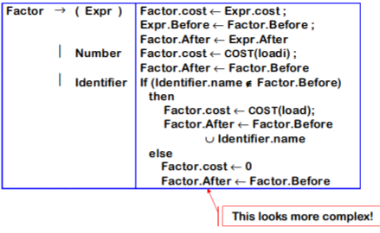
Improving the Example
Adding load tracking
• Need sets Before and After for each production
• Must be initialized, updated, and passed around the tree
Even Semester 2017-18
Nalinadevi Kadiresan

Slide 43
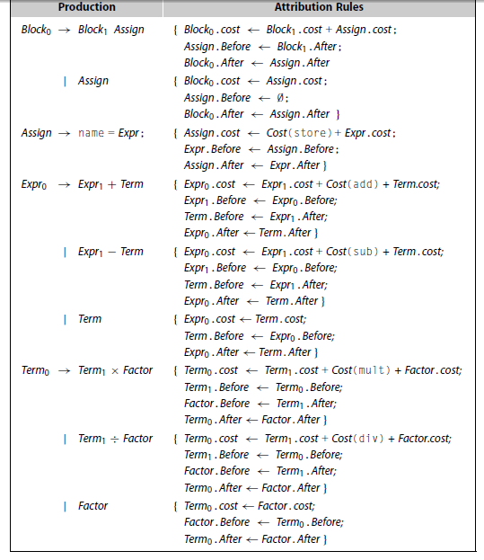
These copy rules multiply rapidly
Even Semester 2017-18
Nalinadevi Kadiresan

Slide 44
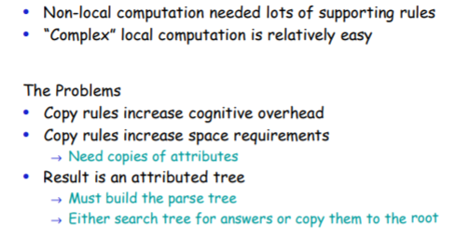
The Moral of the Story
Even Semester 2017-18
Nalinadevi Kadiresan

Slide 45
Problems with Attribute grammar approach - summary
Handling Non local information
Storage Management
Instantiating a parse tree
Locating answers in the tree
Breakdown of Functional Paradigm
Even Semester 2017-18
Nalinadevi Kadiresan

Slide 46
Addressing the Problem
If you gave this problem to a programmer at IBM
Introduce a central repository for facts
  Table of names
    Field in table for loaded/not loaded state
  This avoids all the copy rules, allocation & storage headaches
  All inter-assignment attribute flow is through table
    Clean, efficient implementation
    Good techniques for implementing the table (hashing, B.3)
    When its done, information is in the table !
    Cures most of the problems
Unfortunately, this design violates the functional paradigm
  Do we care? → Yes, the dependency in dependence graph is lost so determining evaluation order is difficult
  Demonstrated in next example
Even Semester 2017-18
Nalinadevi Kadiresan

Slide 47
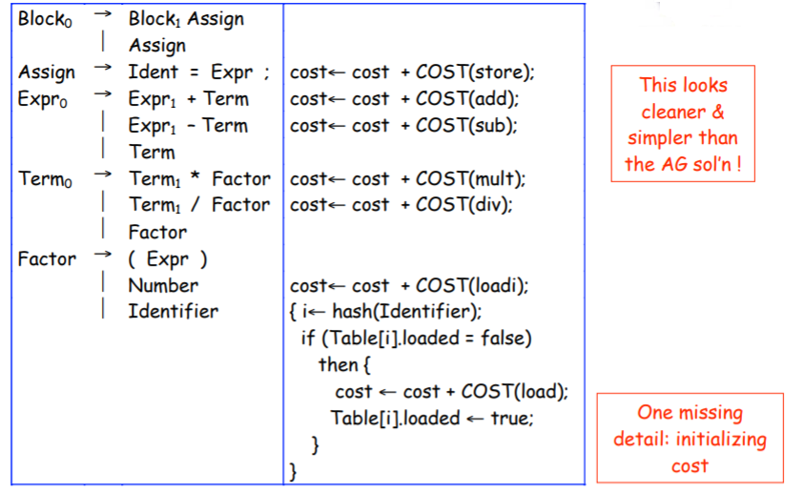
Reworking the Example (with load tracking)
Even Semester 2017-18
Nalinadevi Kadiresan

Slide 48
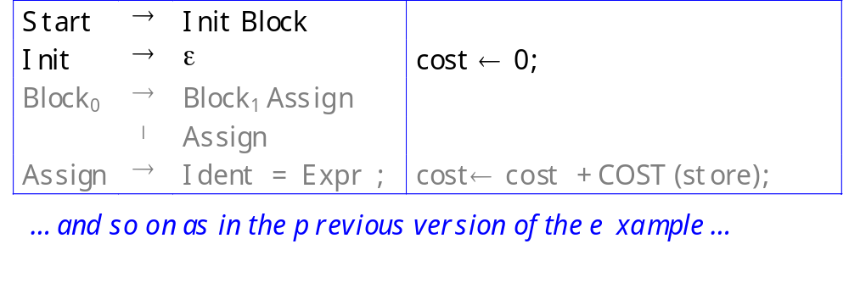
Reworking the Example (with load tracking)
Before parser can reach Block, it must reduce Init
Reduction by Init sets cost to zero
This is an example of splitting a production to create a reduction in the middle — for the sole purpose of hanging an action routine there!
Even Semester 2017-18
Nalinadevi Kadiresan

Slide 49
The Realist’s Alternative
Adhoc syntax-directed translation(AHSDT)
It is a rule based evaluation method (treewalk)
  Analyze rules at compiler-generation time
  Determine a fixed (static) ordering
  Evaluate nodes in that order
Associate a snippet of code with each production
At each reduction/derivation, the corresponding snippet/action is executed
AHSDT nicely fits into parsers
  Top-down, Recursive-Descent Parser
  Bottom-up, shift/reduce Parsers
Even Semester 2017-18
Nalinadevi Kadiresan

